Slide 1

How do we increase communication and collaboration between climate service providers: Towards a network of networks
How do we increase communication and collaboration between climate service providers: Towards a network of networks
How do we increase communication and collaboration between Boundary Organizations (with or without climate services): Towards a new international network
Alain Bourque
DG, Ouranos
Montréal, Canada

Slide 2



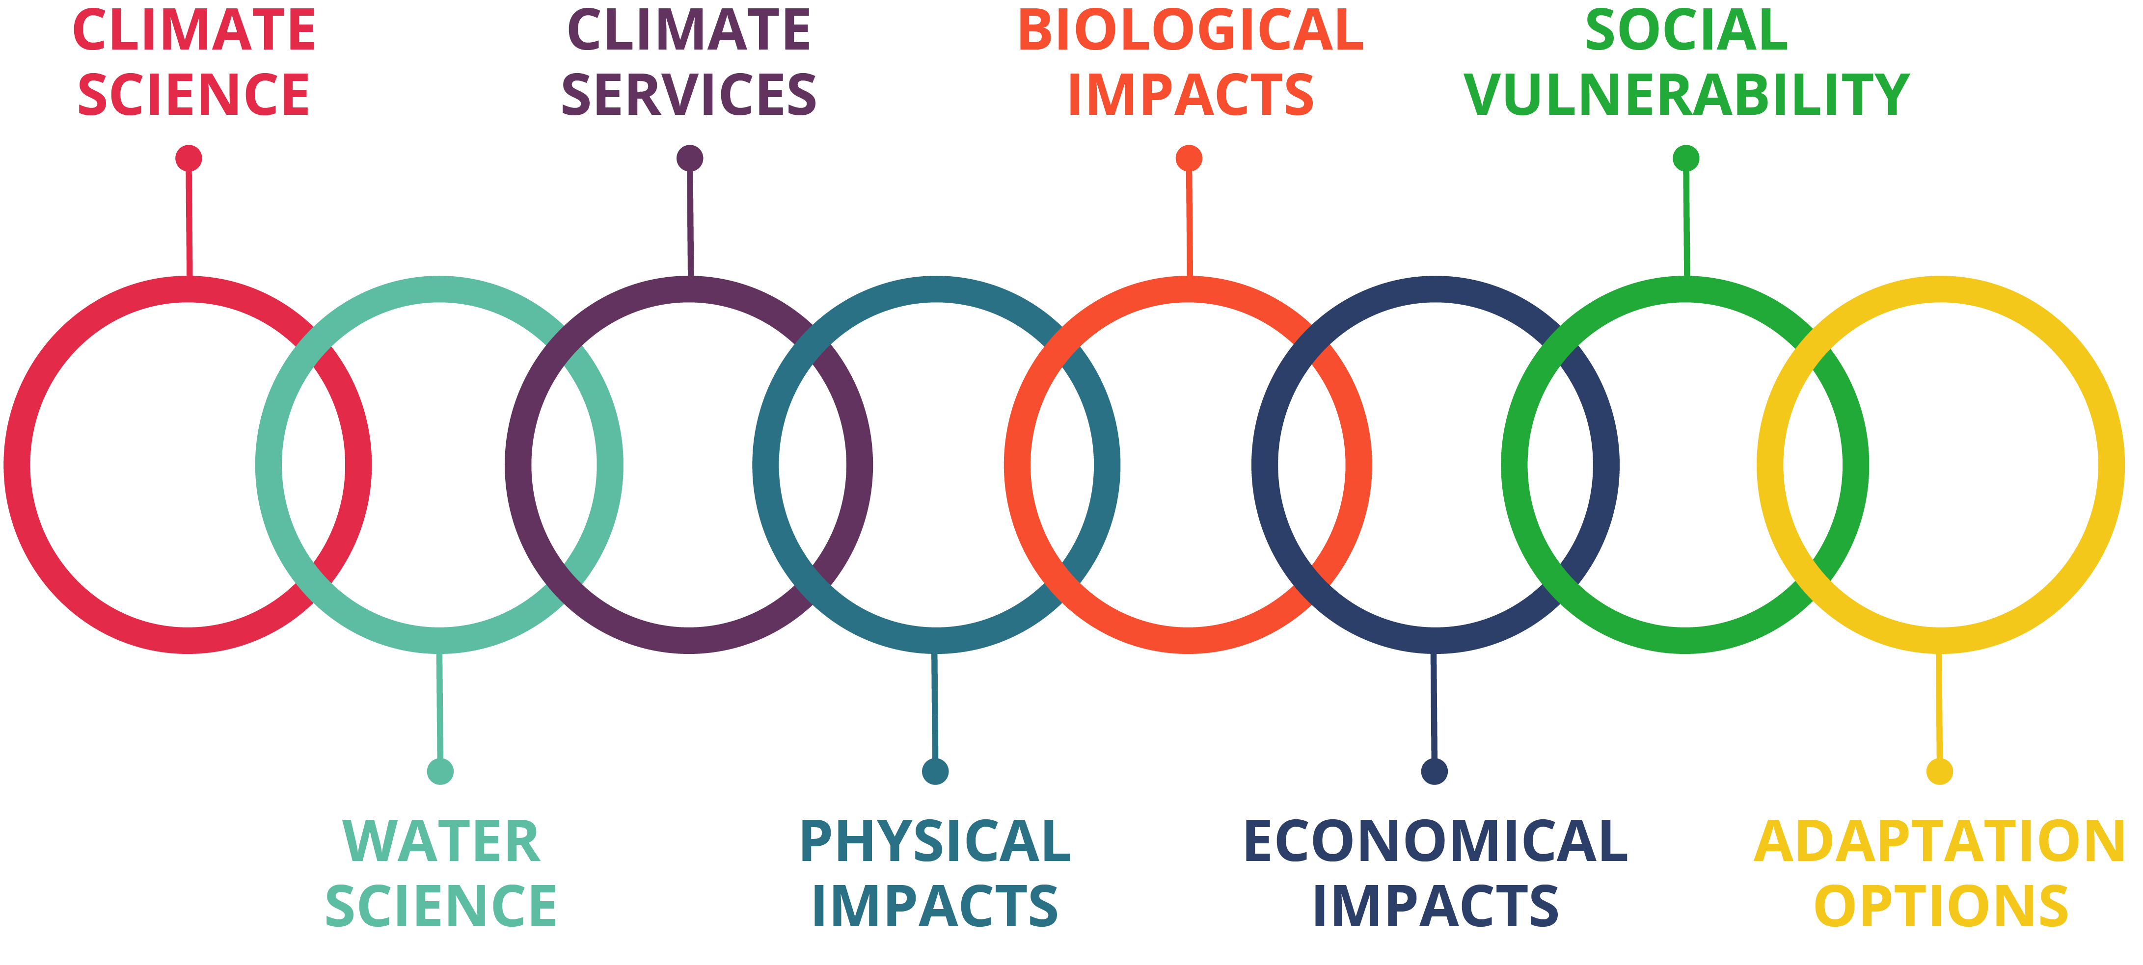
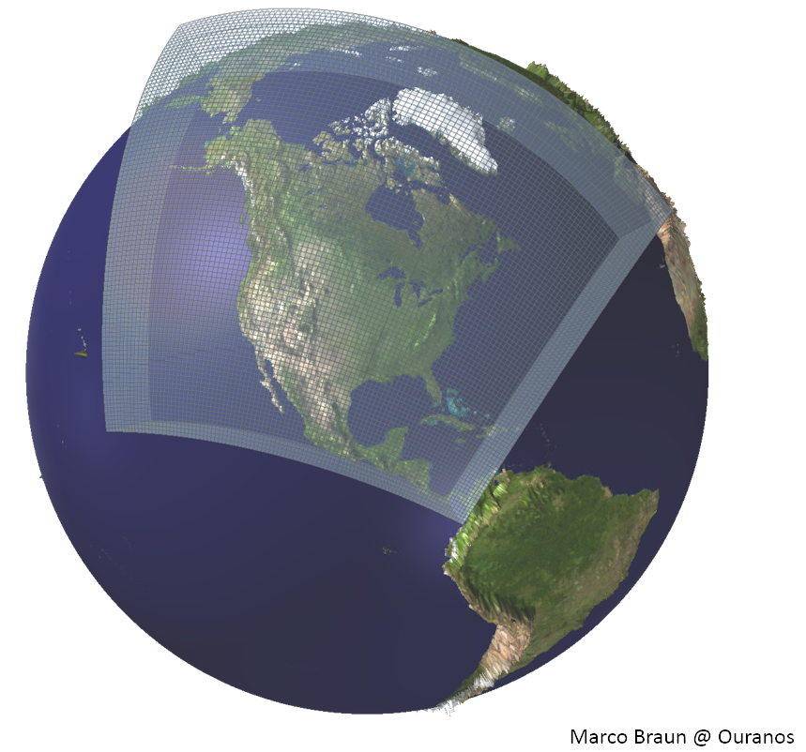
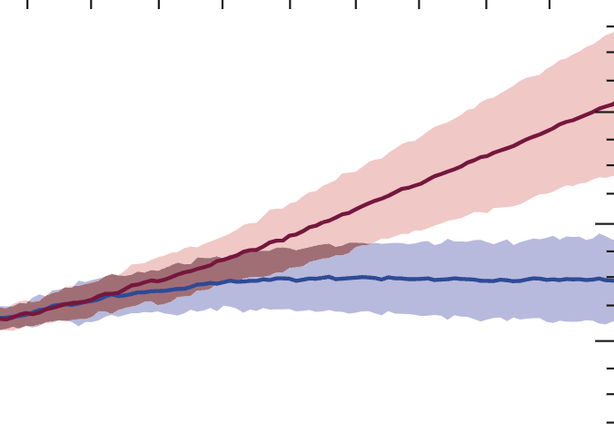
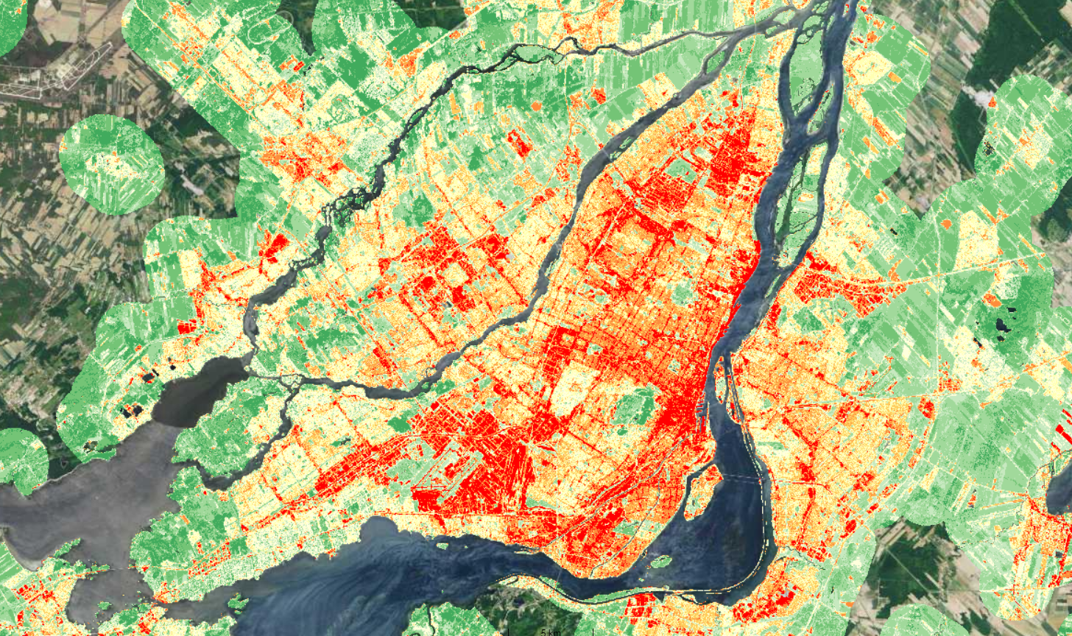
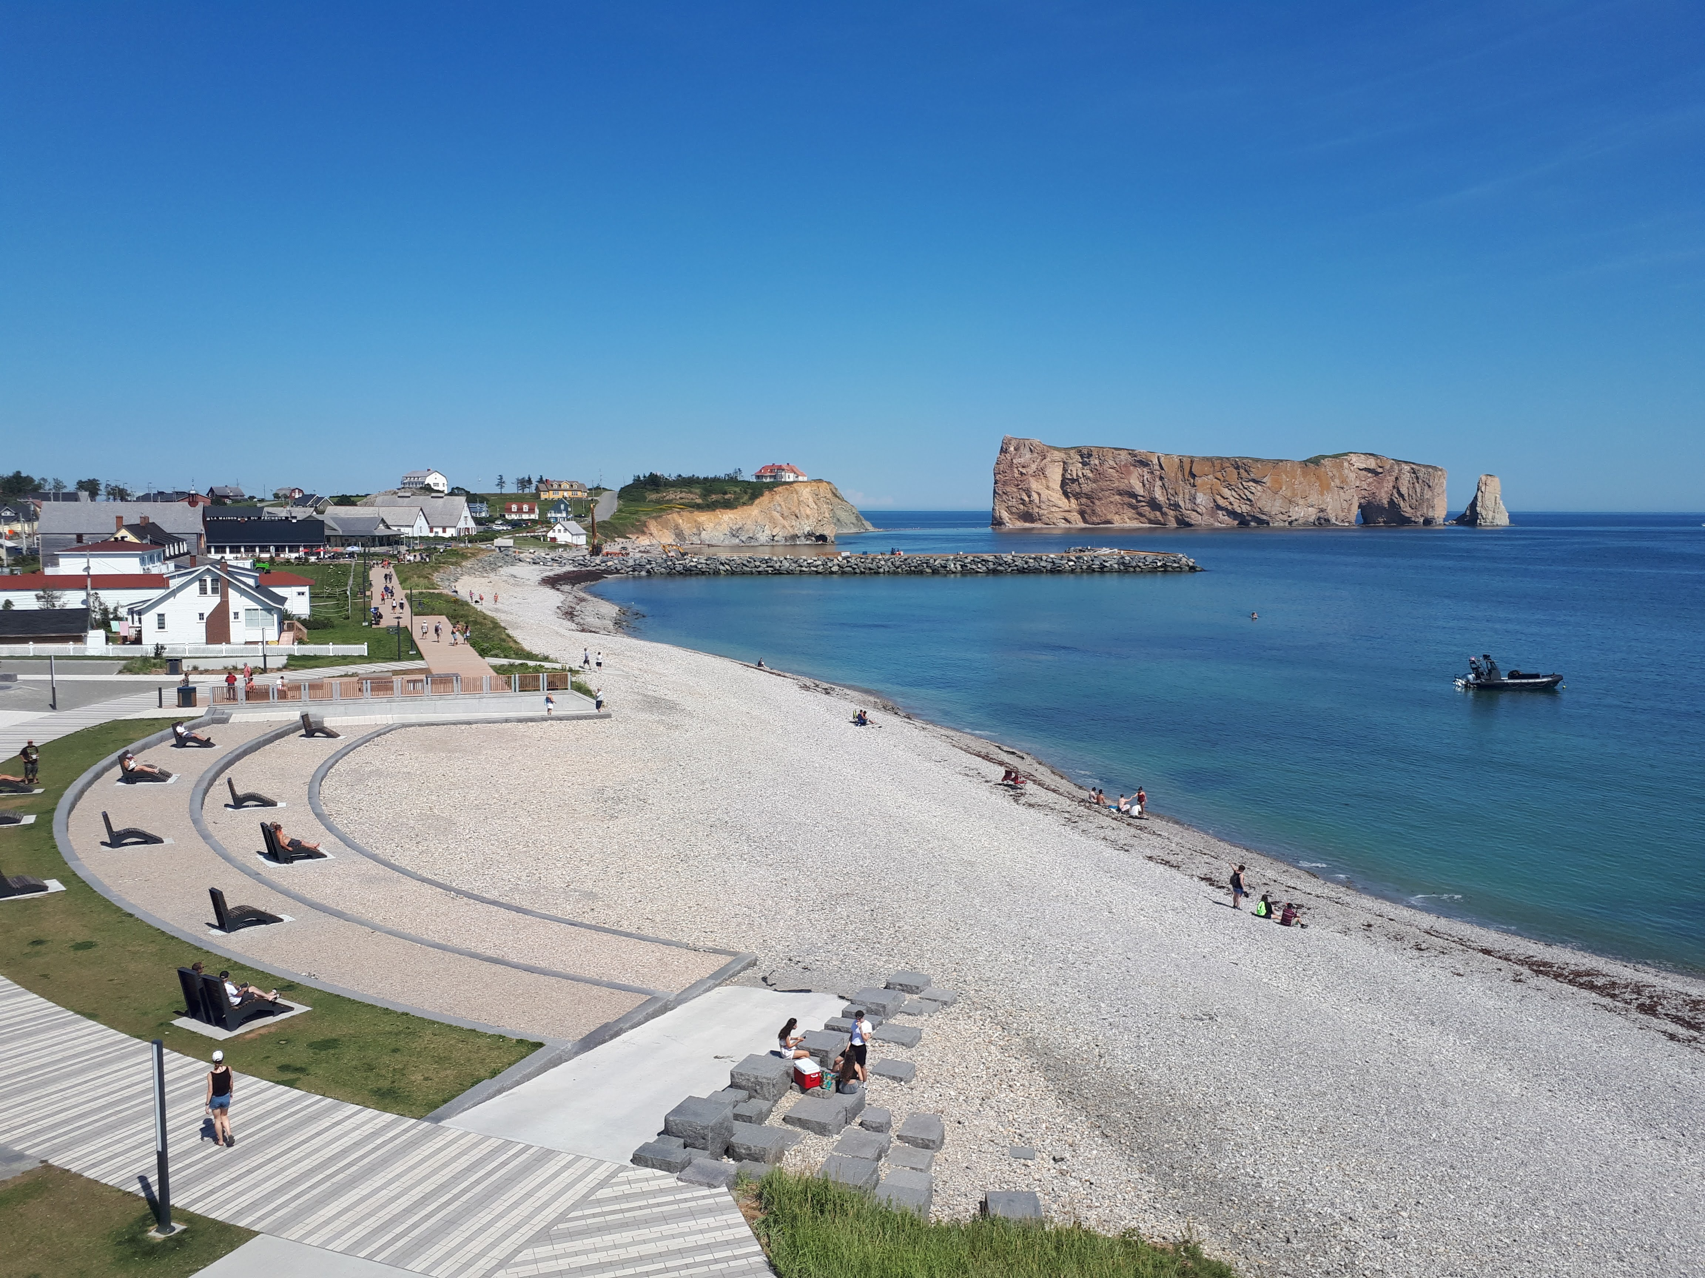
WCRP
WASP
International level
Regional Information
for Society (RIfS-IPO)
Boundary work with focus on regional scale
“User needs”
Tangible outputs
Notes:
First let look at Boundary work in context.

Slide 3

Are Boundary organizations useful?
  The concept of Boundary Organization was introduced over 20 years ago to describe specific organizational efforts to mediate between science and policy/practice/decision making (Guston, 1999)
  Several Boundary Organizations have been successful in the area of adaptation to climate (Cash et al., 2002)
  Connections between climate change science and regional needs/actions remain a challenge
  Through a few events (ECCA2023, Adaptation Futures 2023) and various consultations, we propose that Boundary Organizations will play a more important role in the future but should better connect with each other in other to be more efficient and accelerate successes, including through their climate services component offered by some.

Slide 4
Boundary organizations and capacity building
Potential areas for specific capacity building
Climate science/expertise
Climate services
Development and coordination of applied/multidisciplinary applied projects
Funding strategies (Ex: GCF)
Collaborations with stakeholders
Use of collaborative methods
Influence: Practice, Policy, Decision making
Etc…
Room for increased
organizational capacity?
Lack of sharing can lead to duplication of efforts
(ie. “re-inventing the wheel”)
Work is very focused on regional user needs, less production of publications on approaches
Opportunities for organizational capacity development not always identified
Etc…

Slide 5
Emerging network of Boundary organizations for adaptation
Emergence: informal discussions on and
off since about 2005, event in Montreal on Oct. 4, 2023 (including use of Menti.com)
Network development: bottom-up
Scale of intervention: regional
Geographic scope: global
Niche and mandate to clarify in ongoing discussions with interested BO:
- Independent non-profit BO with strong focus on working directly with stakeholders
- with or without climate services.
Potential linkages and synergies: with adaptation research and climate research and services, depending on vision to be co-developed with members
Conversation with about 30 boundary organizations
from around the world during Adaptation Futures
CSE
Senegal
ICCCAD
Bangladesh
Centre for Transformative Agriculture and Food Systems
South Africa
4C
Morocco
UCCRN
USA…
Futurs-ACT
A region of France
CCCA
Austria
Ouranos
Canada

Slide 6
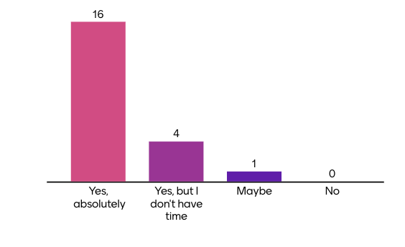
Value in increasing collaboration between boundary organizations?
Side-event during AF2023, , Montreal, Oct. 4, 2023

Slide 7
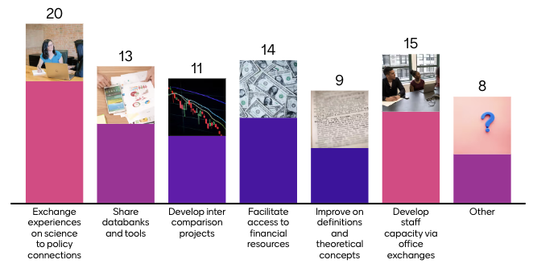
What type of connections could the network stimulate?

Slide 8
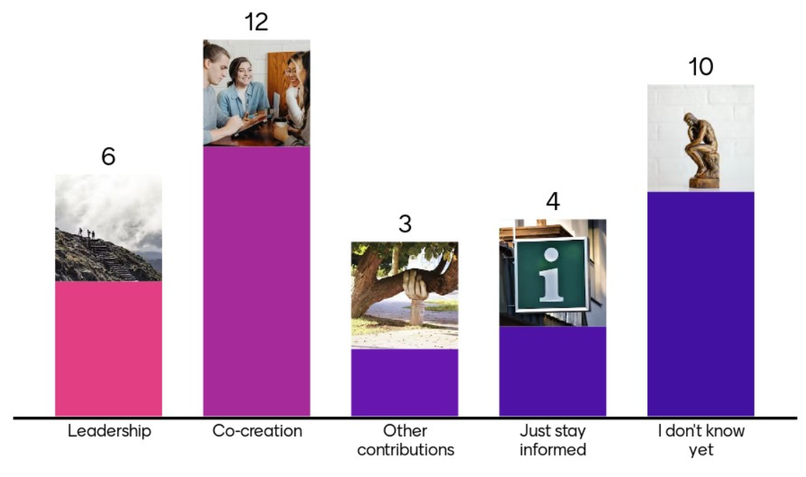
What role would you be interested in playing?

Slide 9
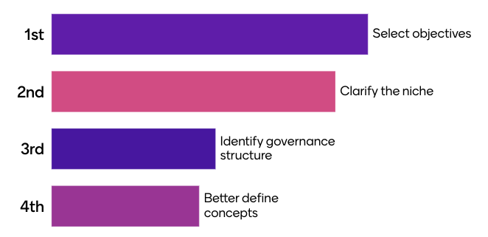
Priority topic we need to work on?

Slide 10
Next steps: A group of BO is moving forward
  Recruitment of members as co-leaders, co-creators or contributors (November to February)
  Event during COP28 to continue discussions (and announcement?)
  Secretariat put in place and start animation (January-March)
  Establishment of governance (February-March)
  If you are interested in joining or for more information: info@ouranos.ca

